Slide 1
Be L33T: Accessibility in Game Development
Presented By:
Jessie Haugh, Accessibility Specialist
James Thompson, Accessibility Consultant
CSUN 2018 Assistive Technology Conference
March 22, 2018
Notes:
Jessie Haugh is an Accessibility Specialist with Level Access and the Head of Research and Development with the Ablegamers Charity. She enjoys creation of new technology to improve quality of life for gamers with disabilities.
James Thompson currently works as an Accessibility Consultant with Level Access. He loves the connection with other people he gets when playing multi-player games of all kinds on all platforms.

Slide 2
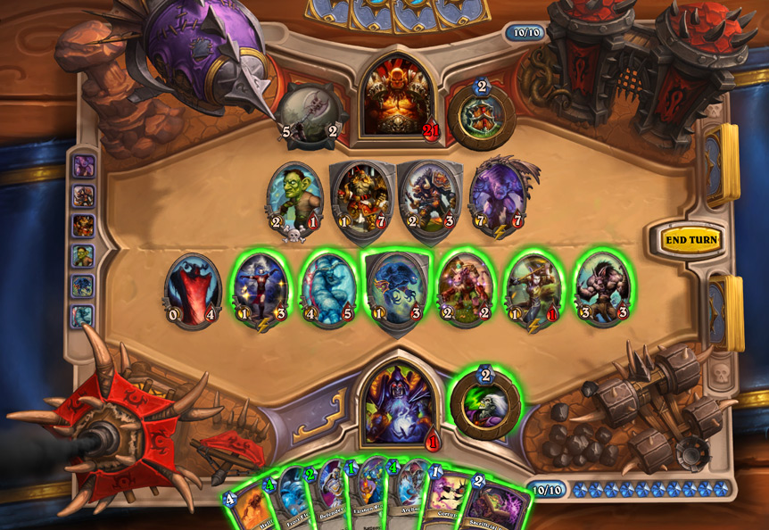
Agenda
Includification & Best Practice Deep Dives
Mobility
Auditory
Visual
Cognitive
Mobile Gaming
Biggest Accessibility Issues
Virtual/Augmented Reality
CVAA
Ending Note – The Need for Play

Slide 3
Includification

Slide 4
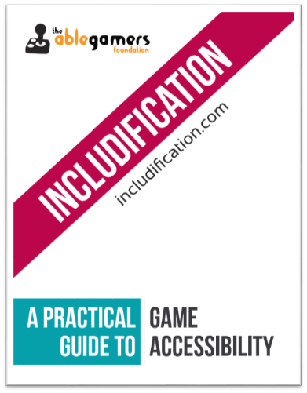
What is Includification
The Ablegamers Includification Guide is the award-winning guidelines to game accessibility written by both developers and gamers with disabilities.
These guidelines delve into the principles of game accessibility, and comes from nearly a decade of research, review, experiments, and first-hand experience
Notes:
Provide link to Includification Guide PDF/Website

Slide 5
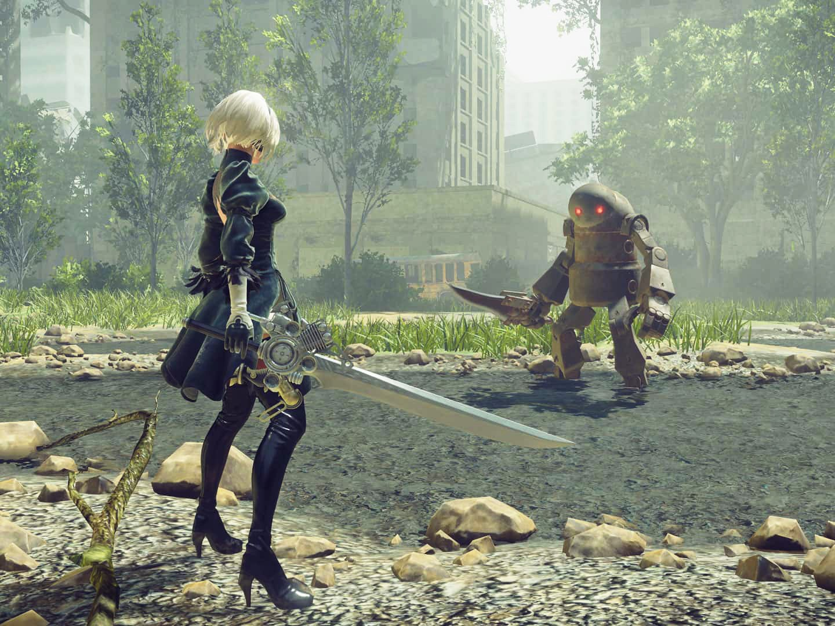
Includification Best Practices
Best practices are broken apart into four sections:
Mobility
Visual
Hearing
Cognitive
From there, each section has best practices divided based on implementation difficulty
First Tier (Level 1)
Second Tier (Level 2)
Third Tier (Level 3)

Slide 6
Includification Best Practices: Mobility
Mobility best practices talks about how to make your game more accessible to gamers with physical disabilities
This includes:
Remappable Keys
Camera Controls
Movable UI
Input Supports

Slide 7
Deep Dive: Camera Controls
Open-world games are ones where an avatar is exploring in three dimensions. This includes MMOs and first-person shooter games.
These games generally require two core camera movements: character movement and camera movement
Precise joystick movement can be troublesome, let alone doubling that requirement with character movement
This is a required mechanic for open world, as without it, then an avatar can only move based on their viewpoint (i.e. straight ahead)
Objective: Comfortable movement for both gamers that can make large movement across the screen or small, precise movements.

Slide 8
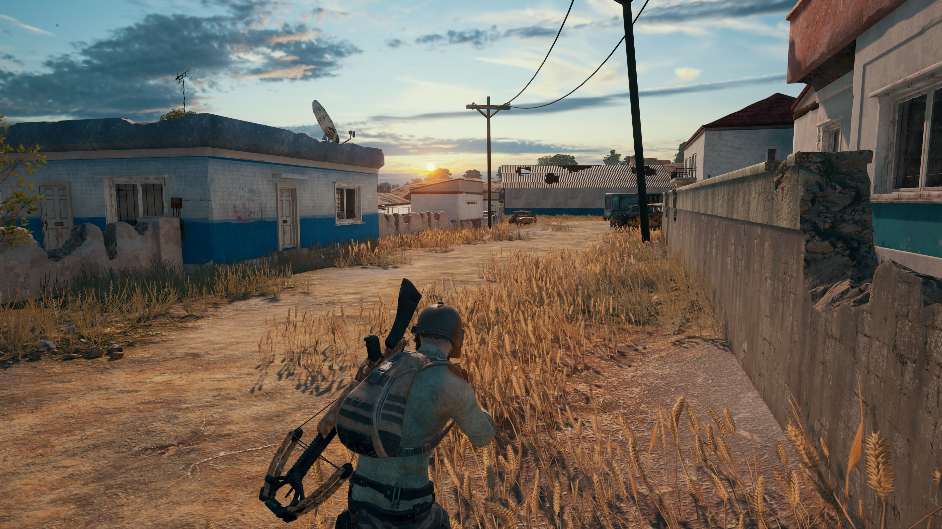
Screen shot of Player Unknown Battlegrounds (PUBG) video game

Slide 9
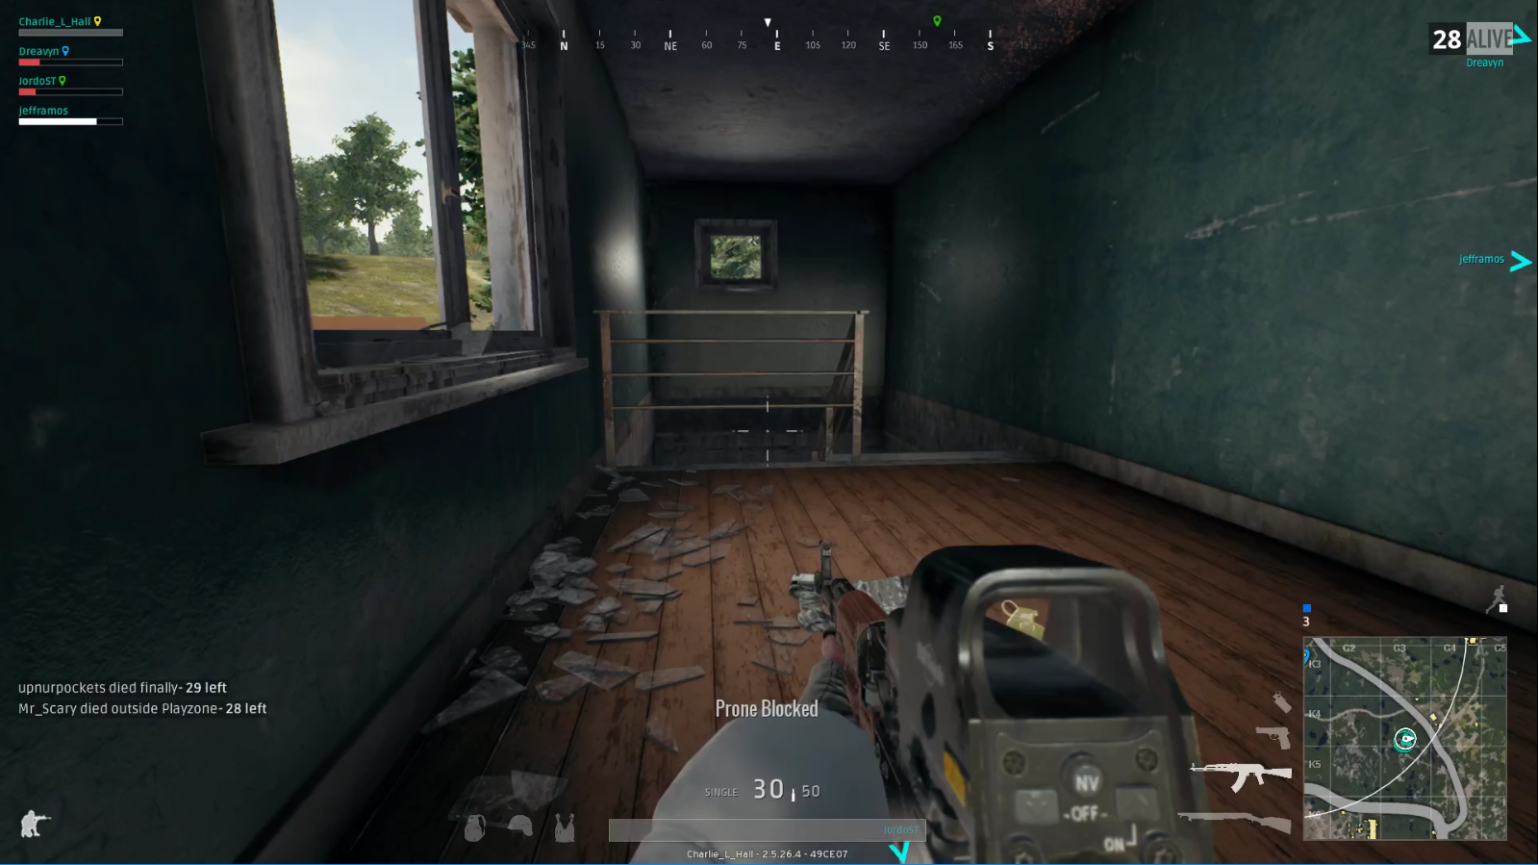
First-person view screen shot

Slide 10
First- vs Third-Person View
Deep Dive: Camera Controls
Gamers with large range of motion, but difficulty with precision:
Provide the ability to translate large mouse movement into a slower camera motion
First-Person View
Gamers with short/precision movement, but difficulty with macro movement:
Allowance to set the camera further out from their character, and provide ability for sensitive camera movement
Third-Person View

Slide 11
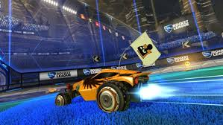
Camera Auto-Follow
Deep Dive: Camera Controls
For games where the objective is to interact with a constantly moving object (i.e. single-boss fight, soccer ball, etc.).
Set camera movement to the object so gamers can solely focus on character movement

Slide 12
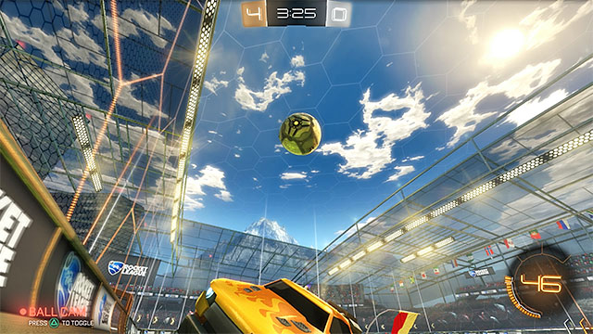
Deep Dive: Camera Controls

Slide 13
Includification Best Practices: Visual
Visual best practices delves into how to make your game more accessible to gamers with a range of visual abilities
This includes:
Changeable Text Colors & Font Sizes
Enemy Marking
Customized HUDS
Text-to-Speech Input

Slide 14
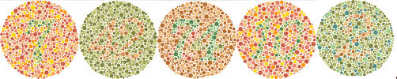
Deep Dive: Enemy Marking
The ability to tell friend from foe is one of the most fundamental differentiators in all video games
Advances in differentiation has improved, however there are times when telling the difference can be difficult for gamers whom are color blind and/or low vision, especially with varying backgrounds
Objective: Available options for gamers to choose how friends and enemies are showcased

Slide 15
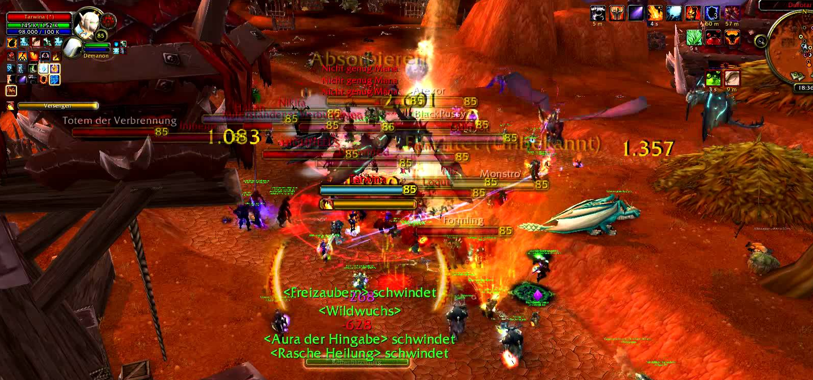
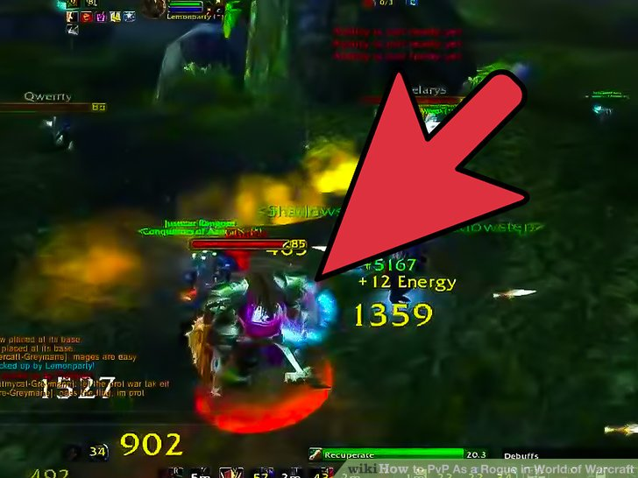
Deep Dive: Enemy Marking
Notes:
Base level 1: Enemy character is designated by color highlight and a unique marking, indicating that this character is Horde (where the core character is an Alliance character). Looked like a Christmas tree in a room for the first-time alt text auto generation

Slide 16
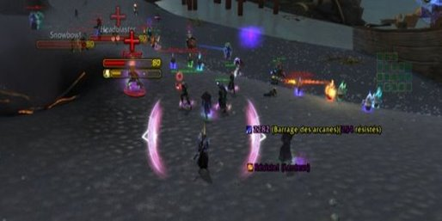
Visual Symbols
Deep Dive: Enemy Marking
Ties into allowance of add-ons/3rd party API
Addition of visual marker over-top the enemy character
In this instance, this add-on only marks the healers

Slide 17
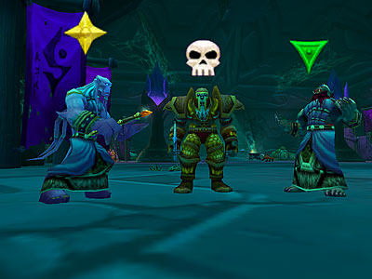
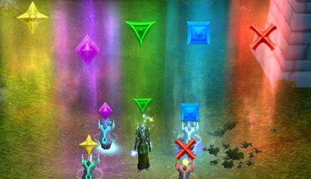
Raid Icons
Deep Dive: Enemy Marking
Icons that can be placed over areas or individuals
100% controlled by the player
Used to indicate attack order, or where to stand during different phases
Example: When the boss begins a certain attack, move to the Yellow Star

Slide 18
Includification Best Practices: Auditory
Auditory best practices talks about how to make your game more accessible to gamers with hearing disabilities
This includes:
Closed Captioning
Changeable Text Colors & Fonts Sizes (repeat)
Ambient Noise as Text Output
Alternative Reactionary Input

Slide 19
Deep Dive: Subtitles vs Closed Captioning
Add my previous slides here
Closed captioning has become a de facto accessibility option
However, it's important to note the difference between subtitles and closed captioning, as sometimes both are used interchangeably
Core difference: closed captioning provides additional audio cues
Example of accessibility features coming from proper design practices
Objective: Capture ambient noise and pitch identification through authentic closed captioning

Slide 20


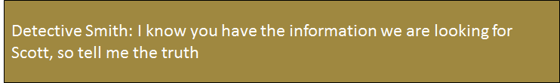
Subtitles

Slide 21

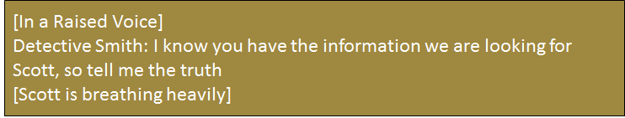
Closed Captioning

Slide 22
Includification Best Practices: Cognitive
Cognitive best practices talks about how to make your game more accessible to gamers with cognitive disabilities
This includes:
Tutorials & Sandbox Modes
Training Levels
Difficulty Level Settings
Reward System Balance

Slide 23
Deep Dive: Training Levels
Add my previous slides here
Training levels allow gamers to practice in a multiplayer environment, however against NPCs of various difficulty levels
This allows gamers whom need more time to prepare for online play to practice and increase their skillset
Gamers can increase their skills in an environment where it mitigates frustration
Objective: Provide varying difficulty levels for gamers to increase their skillset so there is no fear of failure that would negatively affect one's game campaign and mitigate frustration

Slide 24
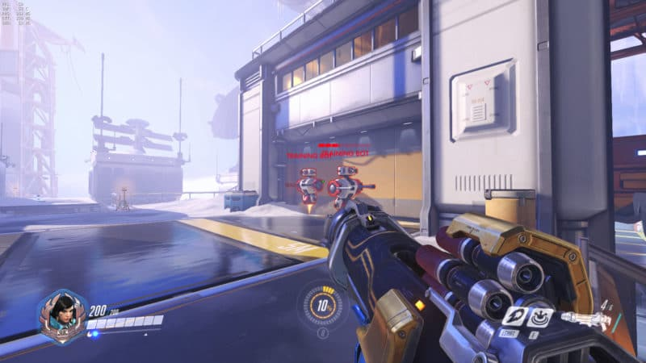
Deep Dive: Screen Shot

Slide 25
Mode 1: Training vs Non-Combative NPCs
Deep Dive: Training Levels
Non-combative NPCs allows gamers to explore new characters and increase their skillset without risk of failure in a competitive environment
Able to practice aiming and movement without an enemy firing back
Best for beginner players as well

Slide 26
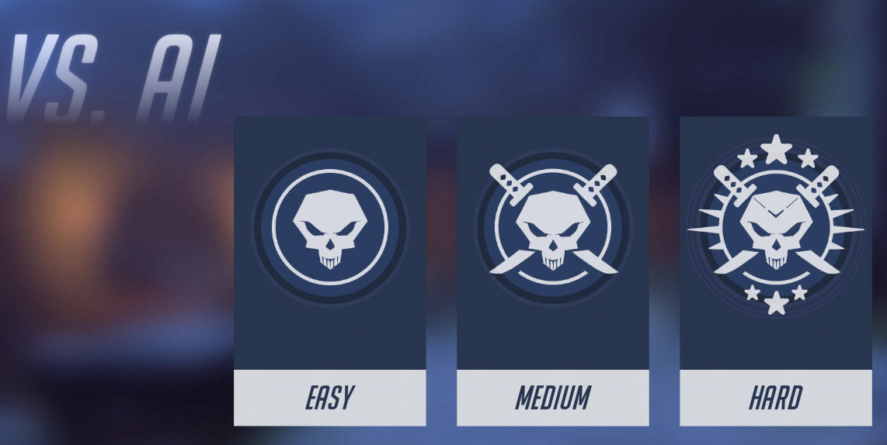
Mode 2: Training vs Combative NPCs
Deep Dive: Training Levels
Combative NPCs provide the next layer of training for gamers.
Providing difficulty levels within the training levels is very beneficial, as it allows continued skillset expansion
Gamers can continue practicing until they feel comfortable entering the online space, not the other way around
Notes:
JT's note: associated icons are not utilizing demeaning images (I.e. easy = bunny, hard = skull).

Slide 27
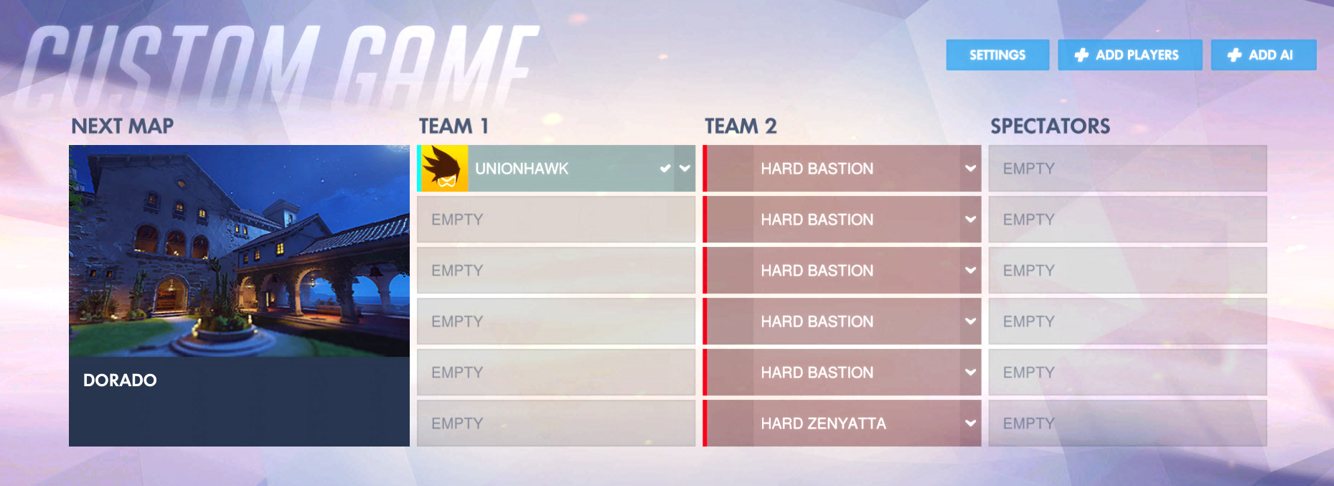
Mode 3: Custom Games
Deep Dive: Training Levels
Notes:
"A screenshot of a cell phone"

Slide 28
Universal Design
In essence, all accessibility best practices, regardless if within web or games, is good design practices at its core
With all development, focus on proper universal design practices, and the accessibility will come with it

Slide 29
Mobile Gaming

Slide 30
State of Mobile Gaming
In 2015, over 51 percent of U.S. mobile phone users were gaming on their devices.
It is expected that starting in 2018 the penetration of mobile gaming in the United States will surpass 60 percent, and in 2020 it is projected to reach 63.7 percent.
Notes:
This means that 2/3rds of this room will admit to playing games on their mobile devices and a few are doing so right now :)
https://www.statista.com/topics/1906/mobile-gaming/
https://www.statista.com/statistics/234649/percentage-of-us-population-that-play-mobile-games/

Slide 31
Best Practices Overview
Mobile Gaming
Touch
Large touch area
Buffer to prevent accidental activation
Multi-touch
Alternative Buttons
High Contrast
Colorblind Options
Speed Settings
Notes:
Touch -

Slide 32
Mobile Gaming: One-Switch Games
Flappy Bird
One switch button can operate the game
One hand accessibility
Spacebar gameplay
https://www.youtube.com/watch?v=6TCbyoPxVdQ

Slide 33
Mobile Gaming: Accessible Puzzle Games
Colorblind Accessibility in Puzzle Fighter
Original Super Puzzle Fighter II Turbo arcade game was notorious for being unplayable for people who are colorblind
Modding community made colorblind accessible hacks of the original
Capcom noticed this and added a colorblind mode to Puzzle Fighter

Slide 34
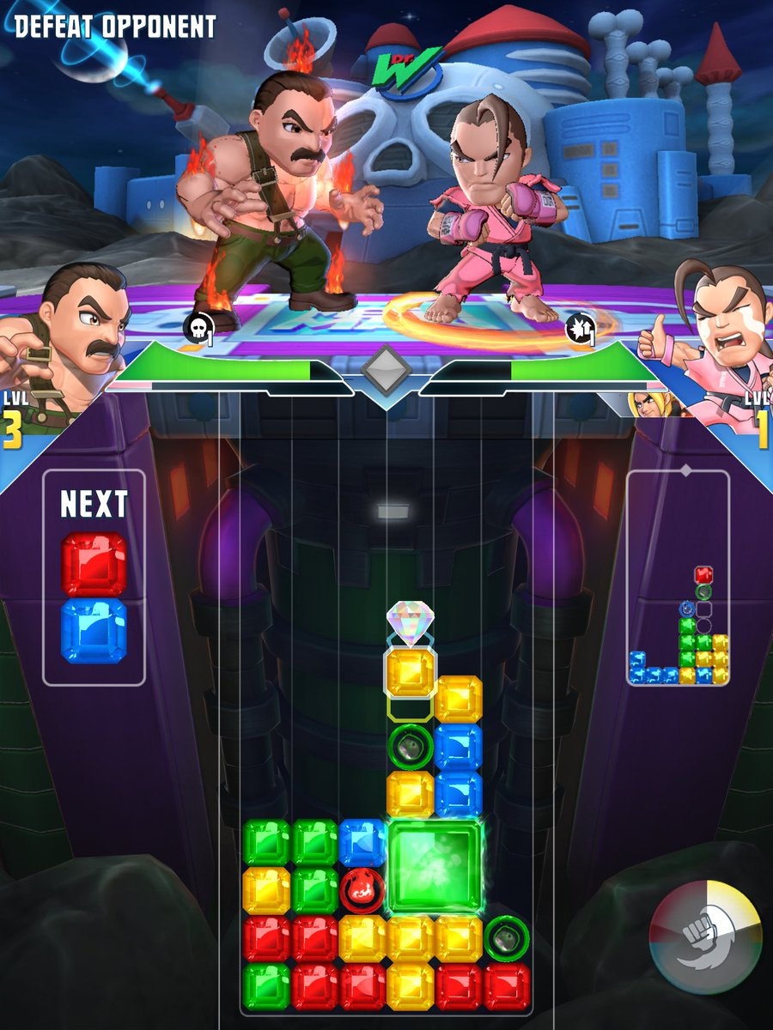
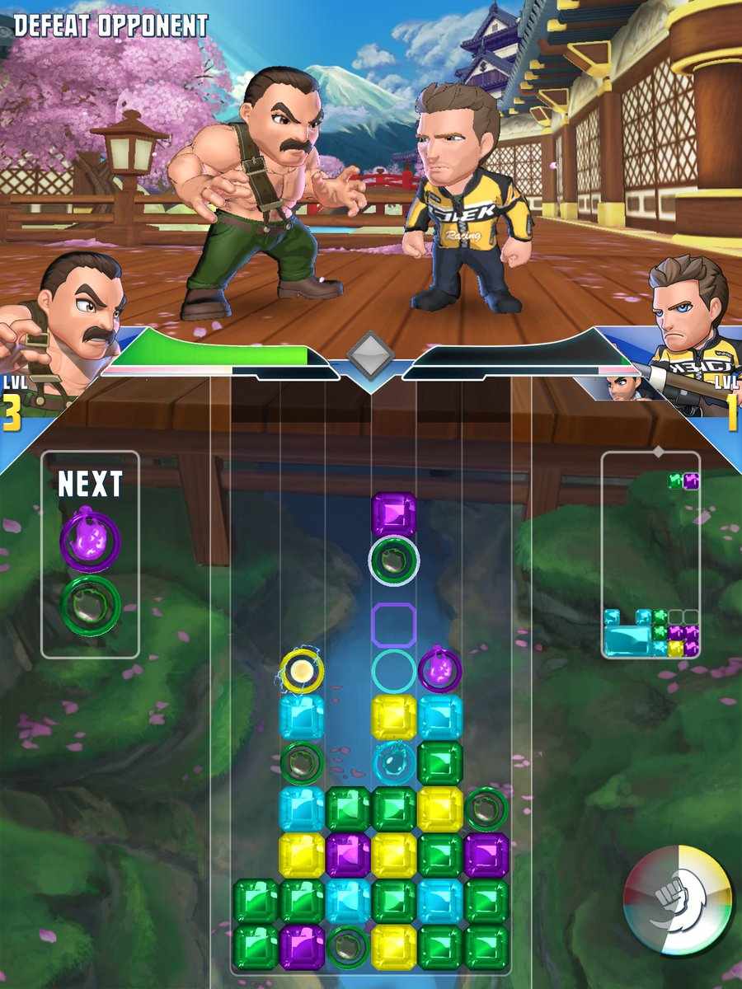
Mobile Gaming: Puzzle Fighter Comparison

Slide 35
Mobile Gaming – Quick Tests
Can you play games on a flat surface?
Can you play games with one hand?
Can you play games without motion?
Can you play games with external input devices?

Slide 36
Biggest Accessibility Issues

Slide 37
Biggest Accessibility Issues Observed
Like with web inaccessibility, there are common cases of game inaccessibility found throughout multiple games
An overarching theme is that game developers are not considering game accessibility early in development
This makes regressively adding accessibility into games difficult
Game accessibility should be considered during pre-production
Accessibility should be a main topic in every game design document/wiki

Slide 38
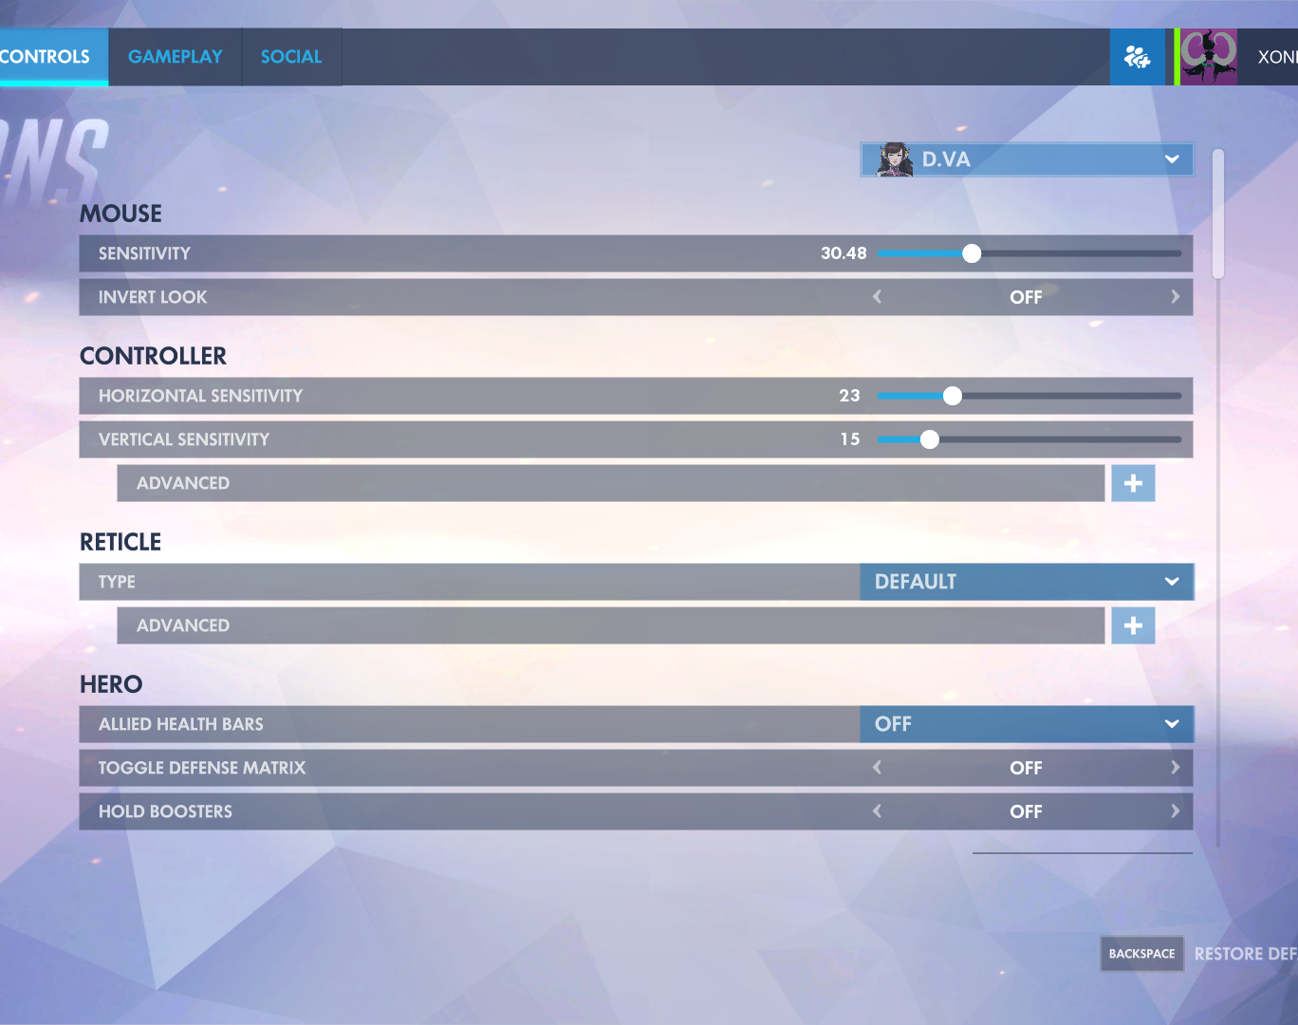
Biggest Accessibility Issues: Remapping
Remapping is currently possible at the OS level
This is good, however, it can be improved upon
Remapping at the game level is better
OS interaction can be left alone, can allow multiple schemes per game
Good Example: Overwatch PC

Slide 39
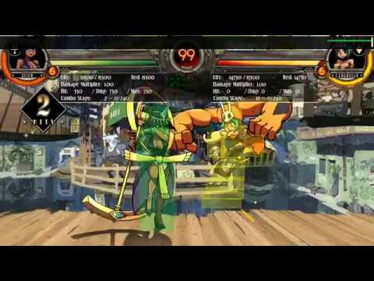
Biggest Accessibility Issues: Narration
Narration is possible at the OS level
This is good, but it can be improved upon
Narration that can hook into game menus is better
Good Example: Skullgirls PC

Slide 40
AbleGamers Player Panels
Ablegamers is partnering with the top publishers, AAA and indie game companies and leading researchers to ensure game accessibility is at the forefront of game development.
Ablegamers is giving people with disabilities the opportunity to be in the game industry
Accessibility Quality Assurance
http://www.ablegamers.org/player-panels/

Slide 41
VR/AR Gaming, CVAA, and Ending Notes

Slide 42
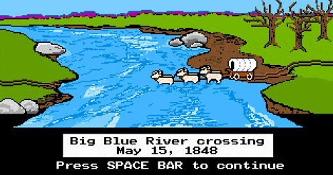
Virtual/Augmented Reality Gaming
Still figuring out how best to support a11y initiatives in the VR/AR space
Current Barriers:
Heavy emphasis on motion controls
Specific requirements on positioning in the space
Strict hardware guidelines
Limited audio
Core-reliance on visual stimulus

Slide 43
CVAA
21st Century Communications and Video Accessibility Act (CVAA)
The CVAA updates federal communications law to increase the access of persons with disabilities to modern communications
https://www.fcc.gov/consumers/guides/21st-century-communications-and-video-accessibility-act-cvaa

Slide 44
CVAA – Current Status in Games
Some OS Level communication exists
Text to Speech, Speech to Text, Narration, and more
One final extension was granted to the game industry
Games must comply by the end of 2018

Slide 45
CVAA – Predications
Game industry will be responsible for accessibility within five (5) years
CVAA is only the beginning
YOU CAN'T RUN FROM ACCESSIBILITY FOREVER, UNNAMED GAME COMPANY!

Slide 46

Ending Note – The Need for Play
Art to storytelling
Extension of oneself
Escape from immediate reality
Overall enjoyment and wellness

Slide 47
Accessible Game Resources
Ea.com/able by Karen Stevens
Sightlesskombat.com by Ben Breen
Unity Accessibility plugin by Michelle K. Martin
Notes:
EA Accessibility Portal where you can get accessibility overviews of EA games, discuss technical issues, and file bug reports
Accessibility Reviews and Guides for those who are blind
An Accessibility plugin for Unity that helps developers make Unity games accessible to screen readers

Slide 48
Questions?

Slide 49






Thank You!
Contact Us
Follow Us
Jessie Haugh
jessie.haugh@levelaccess.com
@LevelAccessA11y
Level Access
Level Access
James Thompson
james.thompson@levelaccess.com
Level Access Blog
Slide Deck Available for Download at: https://www.levelaccess.com/csun18/

